Slide 1
Predicting credit DELINQUENCY
PREDICTIVE ANALYTICS - FINAL PRESENTATION
Scott MItchell
December 2, 2015

Slide 2
Lessons learned
The primary lesson: How to deal with binary predictions where one of the prediction options occurs infrequently
The secondary lesson: Cleaning data also includes understanding nuances of the data including “wrong” data (or data that doesn’t conform to expectations)

Slide 3
Objective and data frame
Prediction Objective: Predict the probability of whether or not a person will experience severe payment delinquency on outstanding debt
Judged on Area Under the Curve (AUC)
Gives the proportion of time guess is correct
Perfect model, AUC = 1
Random chance, AUC = .5
Data: 10 predictors, 150k rows for training / testing
Predictors
Utilization of Credit Limits (Credit Balance / Credit Available)
Age of borrower
Number of times past due (3 levels: 30-59 days, 60-89 days, 90+ days)
Debt ratio ( [Debt + Fixed Mo Expenses] / Monthly Income)
Monthly income
Number of open credit lines
Number for real estate loans
Number of dependents

Slide 4
CLEANING / REVIEWING THE DATA
Raw Data
All ages 21+ except for 1 obs where age is 0
Debt ratio dependent on monthly income, but monthly income missing where debt ratio provided
For these cases, is debt ratio reliable?
If debt ratio is 0 and monthly income is N/A, is debt ratio truly 0 or
is it simply missing?
Credit utilization in excess of 100% in some cases
(max = 5,070,800%)
Monthly income missing nearly 20% of the time
Number of dependents missing 2.6% of the time
Number Times Past Due large gap in values…does ‘98’ have
some other meaning?

Slide 5
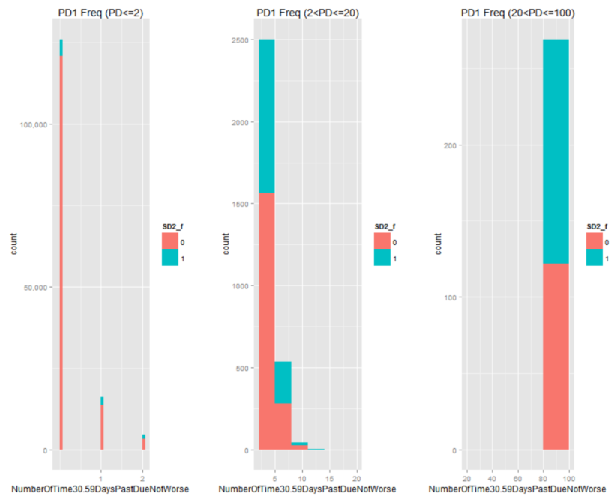
Exploratory data analysis
Chose to assign N/As a unique value far away from true values (for instance, where MonthlyIncome was N/A I assigned 99,999,999)
Challenges
Positive “delinquency” response only occurs 6.7% of the time
Binary response means x/y scatter not useful
Plotted histograms of predictors with relevant breaks filling bars based on Delinquency response
Used gridExtra package to view multiple qplots at once

Slide 6
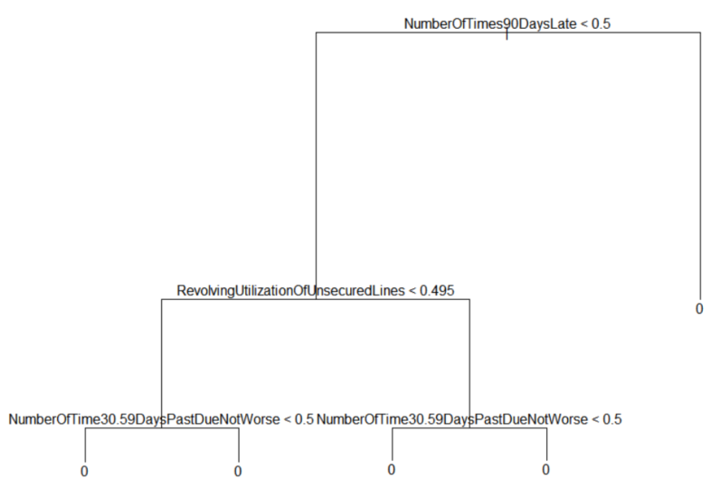
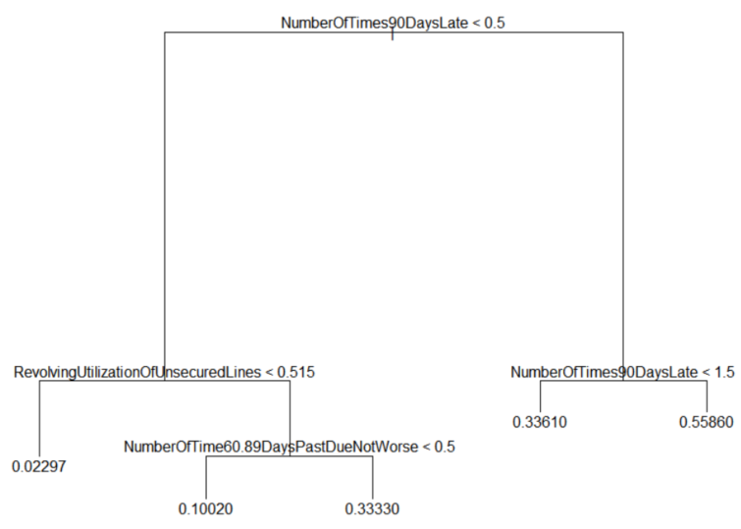
Prediction approach
Use Decision Tree, Bagging, Random Forest, and Gradient Boosting to find best prediction
Need regression, classification doesn’t work well when the chance of a ‘success’ is small
CLASSIFICATION TREE
REGRESSION TREE

Slide 7
Predictions
Installed the pROC package for ease of calculating the AUC
AUC(Response in Test Data, Predictions)
Regression tree model and gradient boosting model ran quickly, but the random forest models took ~1+hr to run/build (on just 75k rows and 10 predictors)
Kaggle #1 = .8696
(winner had 128 entries)

